Slide 1
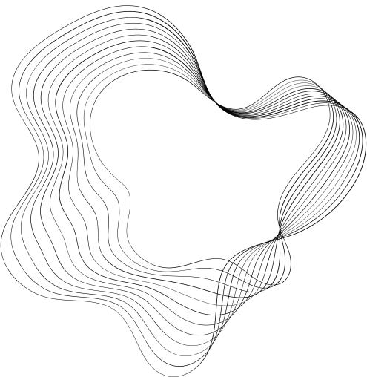

TASK:2
DISEASE PREDICTION
PROJECT

Slide 2
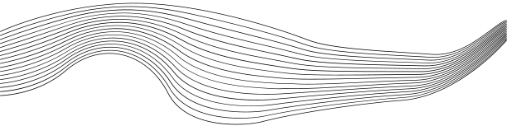
INTRODUCTION
In Machine learning internship ,the project is about to built a dieseses prediction machine learning algorithm model
Disease prediction using machine learning is a rapidly evolving field that leverages advanced computational techniques to analyze vast amounts of medical data and predict the likelihood of diseases. This approach aims to provide healthcare professionals with powerful tools to diagnose and predict diseases more accurately and efficiently, ultimately leading to better patient outcomes.
Objectives
The primary objective of disease prediction models is to develop algorithms that can classify individuals as diseased or non-diseased based on various health attributes. These models utilize patterns and correlations in medical data to make predictions, enabling early diagnosis and intervention, which are crucial in managing and treating diseases effectively.

Slide 3

DISEASE PREDICTION MODEL
Problem Statement: Predictive Modeling for Disease Diagnosis
DOMAIN
Healthcare professionals often rely on various diagnostic tests and biomarkers to assess an individual's
health status and diagnose diseases. In this scenario, we have access to a dataset containing multiple
health-related attributes such as cholesterol levels, blood cell counts, hormone levels, and other
physiological measurements. The dataset also includes information on whether the individual has been
diagnosed with a specific disease or not.

Slide 4
KEY COMPONENTS
Data Collection: The foundation of any machine learning model is data. In the context of disease prediction, data typically includes patient demographics, medical history, laboratory results, imaging data, and other relevant health metrics.
Data Preprocessing: This involves cleaning the data to handle missing values, encoding categorical variables, and scaling numerical features. Proper preprocessing ensures that the data is in a suitable format for training machine learning models.
Feature Selection: Selecting relevant features that have a significant impact on the prediction outcome is crucial. This step involves domain knowledge and statistical methods to identify the most informative attributes.
Model Selection and Training: Various machine learning algorithms, such as logistic regression, decision trees, random forests, support vector machines, and neural networks, can be employed. The choice of algorithm depends on the nature of the data and the specific requirements of the prediction task.
Model Evaluation: Evaluating the performance of the model using metrics such as accuracy, precision, recall, and F1-score is essential to ensure its reliability. Cross-validation techniques are often used to assess the model's performance on unseen data.
Deployment and Monitoring: Once a model is trained and validated, it is deployed in a real-world setting where it can assist healthcare providers in making informed decisions. Continuous monitoring and updating of the model are necessary to maintain its accuracy over time.

Slide 5

MODEL BUILD
LIBRARY AND DATA LOADING:The impoted libraraies are import numpy as np
import pandas as pd
import matplotlib.pyplot as plt
import seaborn as sns
from sklearn.model_selection import train_test_split
from sklearn.preprocessing import StandardScaler, LabelEncoder
from sklearn.ensemble import RandomForestClassifier
from sklearn.metrics import accuracy_score, confusion_matrix, classification_report,roc_auc_score, roc_curve
import tensorflow as tf
from tensorflow.keras.models import Sequential
from tensorflow.keras.layers import Dense, Dropout, Flatten, Conv2D, MaxPooling2D
import scipy.stats as stats
import statsmodels.api as sm
import joblib
import os
then the data is loaded by using pandas library as a csv file.
Data Preprocessing
Handle missing values, encode categorical variables if needed, and scale the features for better model performance.

Slide 6
Explotary Data Analysis
we analysis the structure(shape),head ,tail ,sataistical summary of the data ,description of the data set as individual for train data and test data and hanldle the missing values .
Splitting features and target attribute
# Separate features and target variable
#train data
x_train = train_data.drop('Disease', axis=1) # Features
y_train = train_data['Disease'] # Target variable
# Separate features and target variable
#test data
x_test = test_data.drop('Disease', axis=1) # Features
y_test = test_data['Disease'] # Target variable
The target variable is Disese attribute
Analysis the features and target
Analysis the sturcture ,first few rows ,last few rows of the feature and target adataset

Slide 7

Feature Scaling
from sklearn.preprocessing import StandardScaler
scaler = StandardScaler()
x_train = scaler.fit_transform(x_train)
x_test = scaler.transform(x_test)
select the most important features, you can use feature selection techniques. However, initially, we will use all features.
Selecting the top 10 features (optional)
selector = SelectKBest(f_classif, k=10)
x_train_selected = selector.fit_transform(x_train, y_train)
x_test_selected = selector.transform(X_test)
# For simplicity, we'll proceed without feature selection in this example
x_train_selected = x_train
x_test_selected = x_test

Slide 8
Model Selection and Training
We will use a RandomForestClassifier for this task
Initialize the Random Forest Classifier
model = RandomForestClassifier(n_estimators=100, random_state=42)
Print the model parameters (optional)
print("Random Forest Classifier initialized with the following parameters:")
print(model.get_params())
Train Model
train the model by train data
model.fit(x_train, y_train)
Prediction
Make predictions
y_pred = model.predict(x_test)
Acuuries confusionMatrix Clasification Model
Accuracy
accuracy = accuracy_score(y_test, y_pred)
print(f'Accuracy: {accuracy:.2f}')
# Confusion Matrix
conf_matrix = confusion_matrix(y_test, y_pred)
print('Confusion Matrix:\n', conf_matrix)
# Classification Report
class_report = classification_report(y_test, y_pred)
print('Classification Report:\n', class_report)

Slide 9
Model Evaluation
Evaluate the model using various metrics such as accuracy, confusion matrix, classification report,precision,recall,F1Score
accuracy = accuracy_score(y_test, y_pred)
precision = precision_score(y_test, y_pred, average='macro') # Use 'macro' for multiclass
recall = recall_score(y_test, y_pred, average='macro') # Use 'macro' for multiclass
f1 = f1_score(y_test, y_pred, average='macro') # Use 'macro' for multiclass
# Print evaluation metrics
print(f'Accuracy: {accuracy:.2f}')
print(f'Precision: {precision:.2f}')
print(f'Recall: {recall:.2f}')
print(f'F1 Score: {f1:.2f}')
# Confusion Matrix and Classification Report
conf_matrix = confusion_matrix(y_test, y_pred)
class_report = classification_report(y_test, y_pred)
print('Confusion Matrix:\n', conf_matrix)
print('Classification Report:\n', class_report)

Slide 10
Evalution Output
Accuracy: 0.46 Precision: 0.31 Recall: 0.38 F1 Score: 0.27 Confusion Matrix: [[ 43 31 7 0 3 0] [ 66 160 34 0 32 2] [ 0 1 4 0 0 0] [ 1 22 15 0 1 0] [ 1 23 9 0 15 0] [ 1 11 1 0 1 2]]
Retuning
Retuning, or hyperparameter tuning, is a crucial step in the machine learning model development process. It involves adjusting the hyperparameters of a model to optimize its performance. Here's why retuning is important:
1. Improve Model Performance
Accuracy: Proper tuning can significantly improve the accuracy of the model, ensuring it makes correct predictions more often.
Precision and Recall: Balancing these metrics is essential, especially in medical contexts where false positives and false negatives can have serious consequences.
F1-Score: This metric combines precision and recall, and tuning helps to maximize it, leading to better overall performance.

Slide 11
Retuning outcome
Fitting 5 folds for each of 81 candidates, totalling 405 fits Best Hyperparameters: {'max_depth': None, 'min_samples_leaf': 1, 'min_samples_split': 2, 'n_estimators': 50}
Best Parameters: {'max_depth': None, 'max_features': 'auto', 'min_samples_leaf': 1, 'min_samples_split': 2, 'n_estimators': 50} Best Estimator: RandomForestClassifier(max_features='auto', n_estimators=50, random_state=42)
Train and Prediction after Retuning
Retrain the model with best parameters (if needed)
best_estimator.fit(X_train, y_train)
Make predictions with the tuned model
y_pred_tuned = best_estimator.predict(x_test)

Slide 12

EVALUTE THE TUNED MODEL
accuracy_tuned = accuracy_score(y_test, y_pred_tuned)
precision_tuned = precision_score(y_test, y_pred_tuned, average='weighted')
recall_tuned = recall_score(y_test, y_pred_tuned, average='weighted')
f1_tuned = f1_score(y_test, y_pred_tuned, average='weighted')
This is our diesese Prediction machine learning Model
OUTCOME
Tuned Model Metrics:
Accuracy: 0.4588477366255144
Precision: 0.4992437218467365
Recall: 0.4588477366255144
F1 Score: 0.46661239323134296
Model Visualiztion:
Simple Histogram
STRATEGY N°1
STRATEGY N°2

Slide 13
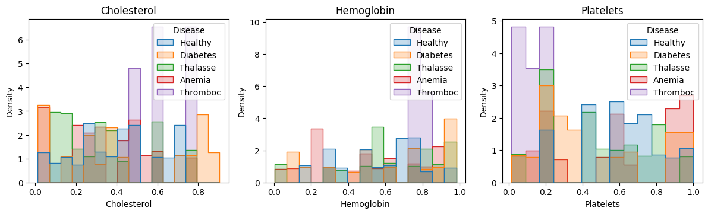
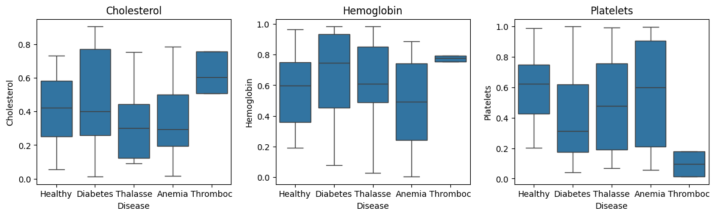
Boxplot
Everest Cantu
Drew Holloway
Remy Marsh
Ceo Of Ingoude Company
Ceo Of Ingoude Company
Ceo Of Ingoude Company

Slide 14
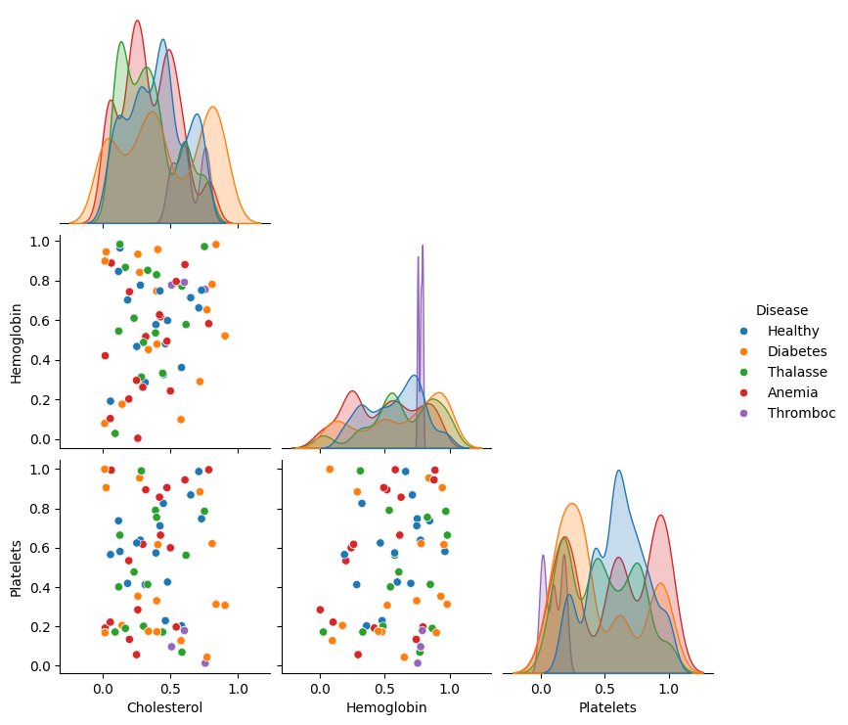
Pairplot
Conclusion
Disease prediction using machine learning represents a transformative approach in modern healthcare, offering significant potential to improve diagnostic accuracy and patient outcomes. By leveraging the power of data and advanced algorithms, these models provide valuable insights and support to healthcare professionals, paving the way for a future where early detection and personalized treatment are the norms in medical practice.

Slide 15

THANK YOU

